Slide 1
Templates

Slide 2
Why Templates?
Imagine that you need a function that to swap whatever that is sent to it as parameters.
One way is to write as many overloads as possible:
Void swap(int, int)
void swap(float, float)
Void swap(double, double)
…
But, it is not easy to cover everything
There is more, you make a copy and paste function which is very wrong! (why?)

Slide 3
Template Functions
Basic idea
same code is re-used for different types
Function template swap
takes one type parameter, T
Definition interchanges values of two passed arguments
of the parameterized type
template <typename T>
void swap(T &lhs,T &rhs) {
T temp = lhs;
lhs = rhs;
rhs = temp;
}
I need to be able to call this function…

Slide 4
Function Templates
We should (but do not have to, in some cases) specify the type of the parameters when we call a Template Function
Compiler instantiates the function template definition using type int
template <typename T> void swap(T &lhs,T &rhs) {
T temp = lhs;
lhs = rhs;
rhs = temp;
}
int main () {
int i = 3;
int j = 7;
swap<int> (i,j);
return 0;
}

Slide 5
Function Templates
Compiler infers type is really int when swap is called
Compiler instantiates the function template definition using type int
template <typename T> void swap(T &lhs,T &rhs) {
T temp = lhs;
lhs = rhs;
rhs = temp;
}
int main () {
int i = 3;
int j = 7;
swap (i,j);
return 0;
}

Slide 6
Why Class Templates?
Now, suppose that we would like to have a class Array that holds an array of anything that is given to it with any, but similar type, items
One way is to create a class with many attributes of different types
class Array {
public:
Array(const int size);
~Array();
private:
int * values_;
float * values_;
double * values_;
…
const int size_;
};
But again, this is not the right way!

Slide 7
Template Class
Basic Idea:
A class that can have variable attribute types
Parameterized type T must be specified in class template declaration
Both as a parameter, and where it’s used in the class
template <typename T>
class Array {
public:
Array(const int size);
~Array();
private:
T * values_;
const int size_;
};

Slide 8
Creating Objects of Template Classes
When an instance is declared, must also explicitly specify the concrete type parameter
E.g., int vs. string in function main()
In previous function template example, didn’t have to say swap<int>
template <typename T>
class Array {
public:
Array(const int size);
~Array();
private:
T * values_;
const int size_;
};
int main() {
Array<int> a(10);
Array<string> b(5);
return 0;
}

Slide 9
Creating Objects of Template Classes
What happens in the background?
compiler creates a new class with the given template argument. In the previous case we have two classes:
class Array {
public:
Array(const int size);
~Array();
private:
int * values_;
const int size_;
};
class Array {
public:
Array(const int size);
~Array();
private:
string * values_;
const int size_;
};

Slide 10
Template Classes with Template Functions
Suppose that our Array class needs a swap function
template <typename T>
class Array {
public:
Array(const int size);
~Array();
void swap(T &lhs,T &rhs);
private:
T * values_;
const int size_;
};
Note that T is already defined for swap via the Template Class, so we do not need to declare it again

Slide 11
Template Classes with Template Functions: Implementing
We need to implement the functions as inline (or at least in the same file) when we use templates. (or you can use .tpp files – for your own research) Why?
template <typename T>
class Array {
public:
Array(const int size);
~Array();
void swap(T &lhs,T &rhs);
private:
T * values_;
const int size_;
};
template <typename T> void Array<T>::swap(T &lhs,T &rhs) {
T temp = lhs;
lhs = rhs;
rhs = temp;
}

Slide 12
Notes on Templates
A template parameter can also be a non-type parameter, such as an int.
is an expression whose value can be determined at compile time
must be:
constant expressions
addresses of functions or objects with external linkage
addresses of static class members
Non-type template arguments are normally used to initialize a class or to specify the sizes of class members.
template <int N_TP>
class Array {
double data[N_TP];
};
Int main(){
Array<200> x;
}

Slide 13
Template Functions as Class Members
Templates can also be member functions.
class A {
template <typename T>
void swap(T &l, T &r);
};
template <typename T>
void A::swap(T &l, T &r){}

Slide 14
Partial Specialization
A template can be specialized for particular template arguments.
template <typename T>
void swap(T &v1, T &v2) { T t = v1; v1 = v2; v2 = t; }
template <>
void swap<Foo>(Foo &f1, Foo &f2) {
swap(f1.impl_ptr, f2.impl_ptr); }
A class template can also partially specialized
template <typename T1, typename T2>
class Foo {…};
template <typename T1>
class Foo<T1, int> {…};
template <typename T1>
class Foo<T1, double> {…};

Slide 15
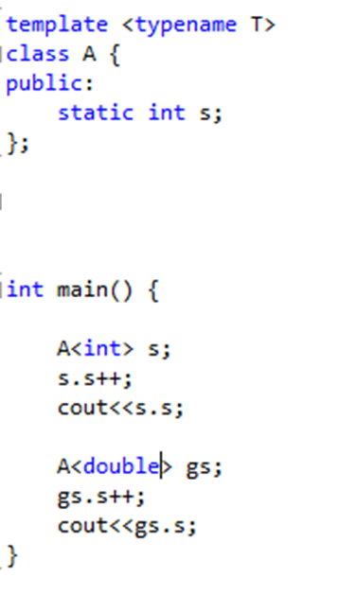
Template and static
Output?

Slide 16
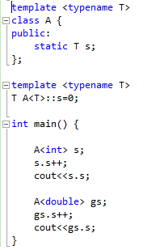
Template and static
Output?

Slide 17
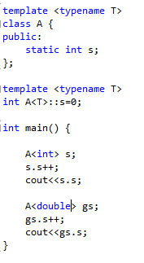
What about this?

Slide 18
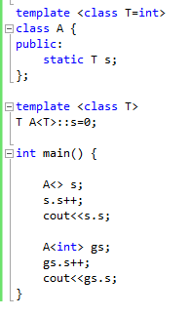
And here?
What do you think about this?
template<class T = char, class U, class V = int> class X { };

Slide 19
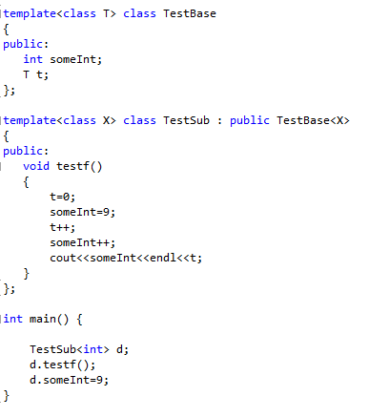
Templates and Inheritance
The best practice is to call template base
Attributes and members using “this” pointer
Or scope operator “::”
This->t;
This->someInt;
TestBase<X>::t;
TestBase<X>::someInt;

Slide 20
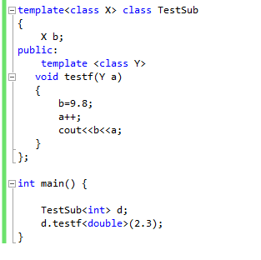
Template Member functions

Slide 21
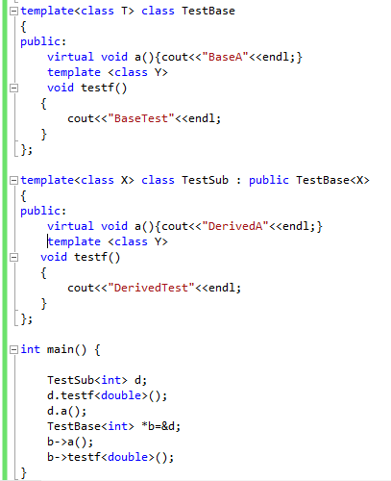
Templates and Virtual keyword
What is the output?

Slide 22
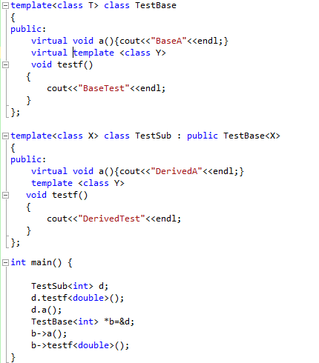
Virtual Template member functions
What about this?
Template member functions cannot be
Declared as virtual, so the following code
Has a compile time error

